Slide 1
Texas’ Tax System: Why We need to Change it Texas Latino Policy Forum
Dick Lavine
Lavine@EveryTexan.org
@dlavine
December 2, 2021

Slide 3
Texas Households With the Lowest Income Pay
the Highest Percentage in State and Local Taxes
Source: Texas Comptroller of Public Accounts, Tax Exemptions & Tax Incidence, December 2020

Slide 4
Top One-Fifth of Texas Households Pay Less
Than Their Fair Share of State/Local Taxes
Source: Texas Comptroller of Public Accounts, Tax Exemptions & Tax Incidence, December, 2020

Slide 10
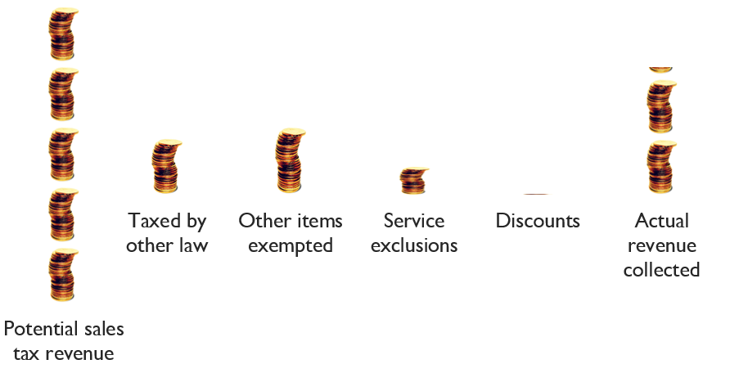
Sales Tax Exemptions
$163 billion (2022-2023) MINUS $92 billion = $71.4 billion
$32 b $37 b
$22 b $601 million

Slide 11
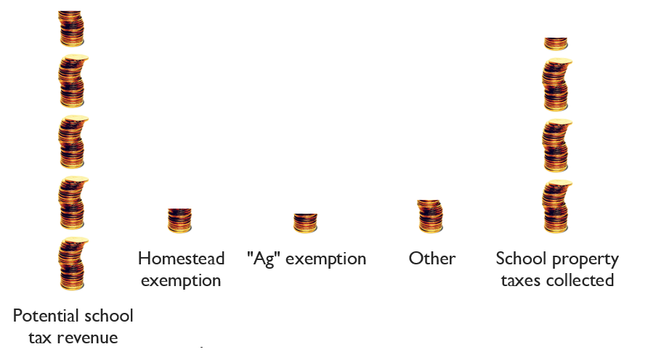
School Property Tax Exemptions
$96 billion (2022-23) MINUS $30 billion = $66 billion
$9 b $9 b
$12 b

Slide 12
Suits Index (from most fair to least fair)
Oil production -0.041 (most fair)
Natural gas production -0.061
Franchise -0.083
School property -0.113
Motor vehicle sales -0.216
Sales -0.241
Gasoline -0.267
Insurance premium -0.282 (least fair)

Slide 13
Some Non-Texans Pay Texas Taxes
Percent Paid By Non-Texans
Natural gas production 65.7%
Oil production 65.4%
Franchise 36.9%
Sales 20.8%
School property 20.1%
Motor vehicle sales 11.4%
Gasoline 11.2%
Insurance premium 6.8%

